Slide 1
SMARTBRIDGE Summer Internship Program - 2019
PROJECT REPORT
Project Title : MULTI-TASKING SMART ROBOTIC CAR
Presented by:
T.N.L.Sreya
N.Jayasree
K.L.Tulasi

Slide 2
COMPONENTS REQUIRED:
ESP 32 Board
Arduino IDE
Gas sensor
Fire sensor
Ultrasonic sensor
Buzzer
LED
Motor driver
2 DC Motors

Slide 3
BLOCK DIAGRAM:
POWER SUPPLY
ThingSpeak cloud
GAS SENSOR
ESP32
FIRE SENSOR
LED
ULTRASONIC SENSOR
BUZZER
MOTOR DRIVER
FRONT
BACK
MOTOR 1
MOTOR 2
RIGHT
LEFT

Slide 4
PROJECT DESCRIPTION:
Now a days there is increase in number of fire accidents and due to release of harmful gases from industries , leads to an increase in death rate. Inorder to avoid this , we developed a smart robotic car , which consists of three sensors i.e., fire, gas, ultrasonic sensors. If any harmful gases are detected or any fire accidents take place , there will be an LED and buzzers which will alert the people near by.

Slide 5
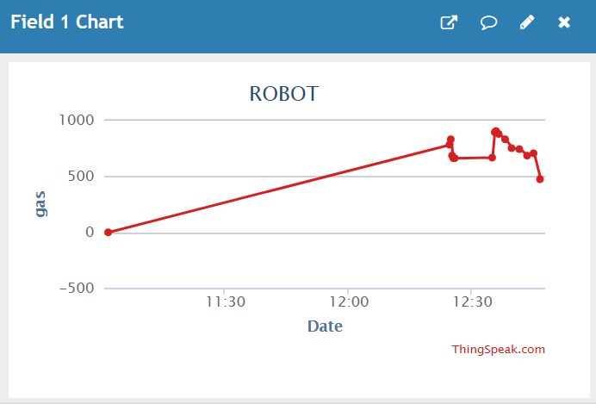
RESULT:
GAS SENSOR:
DESCRIPTION:
Gas sensor module is useful for gas leakage detection.
When the harmful gases are detected from an industry, the gas sensor immediately helps to alert the near by people through a buzzer and an LED.

Slide 6
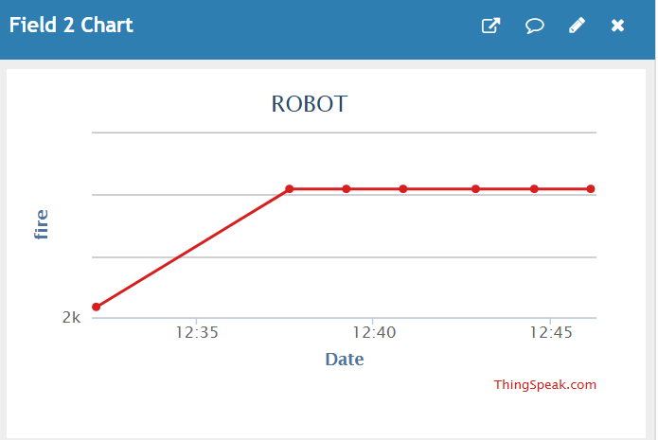
FIRE SENSOR:
A fire detector works by detecting smoke/heat.
After the device has been activated ,it will send a signal to an alarm system to alert the near by people.

Slide 7
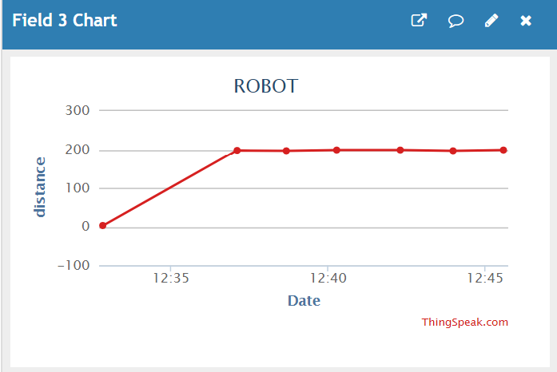
ULTRASONIC SENSOR:
An ultrasonic sensor is a device that can measure the distance to an object by using sound waves.
Works on the principle of SONAR and RADAR system.

Slide 8
THANK YOU

